Slide 1









































Machine Learning Basic Concepts
!"#$%&" (
Feature 2
!"#$%&" )
Feature 1
*"+,-,./ 0.%/1#&2

Slide 2

Terminology
Machine Learning, Data Science, Data Mining, Data Analysis, Sta- tistical Learning, Knowledge Discovery in Databases, Pattern Dis- covery.

Slide 3
Data everywhere!
Google: processes 24 peta bytes of data per day.
Facebook: 10 million photos uploaded every hour.
Youtube: 1 hour of video uploaded every second.
Twitter: 400 million tweets per day.
Astronomy: Satellite data is in hundreds of PB.
6. . . .
7. “By 2020 the zettabytes...”
digital universe will reach 44
The Digital Universe of Opportunities: Rich Data and the Increasing Value of the Internet of Things, April 2014.
That’s 44 trillion gigabytes!

Slide 4
Data types
Data comes in different sizes and also flavors (types):
☒ Texts
☒ Numbers
☒ Clickstreams
☒ Graphs
☒ Tables
☒ Images
☒ Transactions
☒ Videos
☒ Some or all of the above!

Slide 5
Smile, we are ’DATAFIED’ !
Wherever we go, we are “datafied”.
Smartphones are tracking our locations.
We leave a data trail in our web browsing.
Interaction in social networks.
Privacy is an important issue in Data Science.

Slide 6

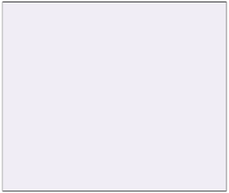
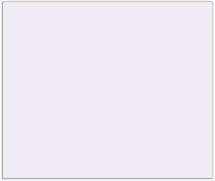






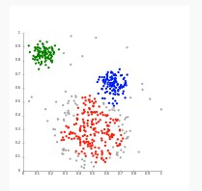

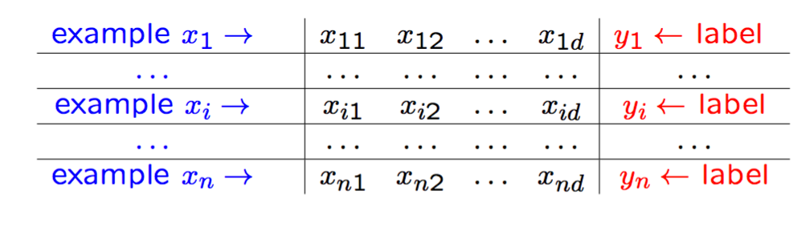

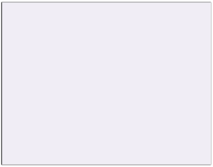
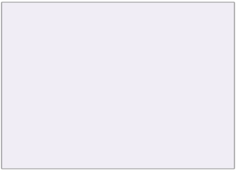
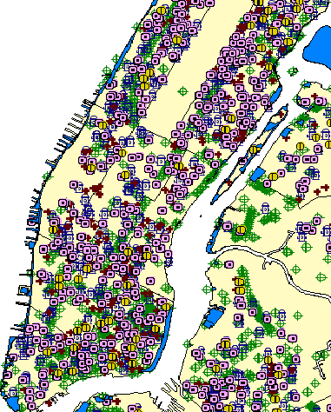
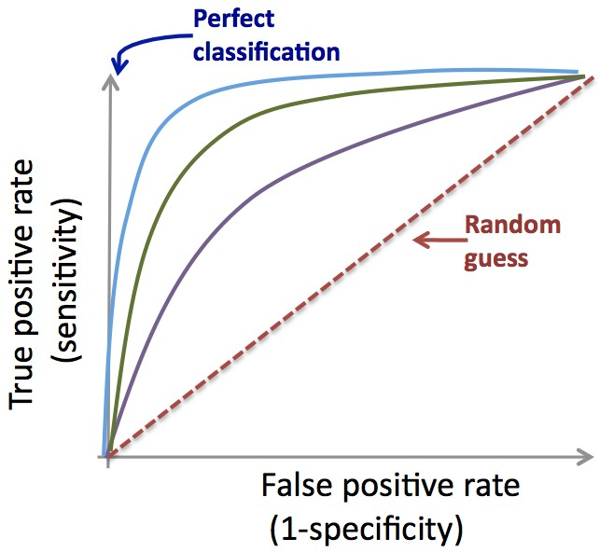





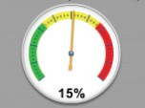

The Data Science process
1
DATA COLLECTION
2
DATA PREPARATION
3
EDA
Data cleaning
Descriptive statistics, Clustering Research questions?
A and B  C
DB
Static Data.
Static
Data.
Feature/variable engineering
Domain expertise
Time
5
Visualization
4 MACHINE LEARNING
Application deployment
Classification, scoring, predictive models, clustering, density estimation, etc.
+
+
-
+
+
-
-
+
+
-
-
+
+
-
Data-driven decisions
Model (f)
-
Predicted class/risk
Yes / 90%
Dashboard

Slide 7

Applications of ML
We all use it on a daily basis. Examples:

Slide 8
Machine Learning
Spam filtering
Credit card fraud detection
Digit recognition on checks, zip codes
Detecting faces in images
MRI image analysis
Recommendation system
Search engines
Handwriting recognition
Scene classification
etc...

Slide 9








Interdisciplinary field
Statistics
Biology
Visualization
ML
Signal
Engineering
Economics
processing
Databases

Slide 10
ML versus Statistics
Statistics: Machine Learning:
Hypothesis testing
Experimental design
Anova
Linear regression
Logistic regression
GLM
PCA
Decision trees
Rule induction
Neural Networks
SVMs
Clustering method
Association rules
Feature selection
Visualization
Graphical models
Genetic algorithm
http://statweb.stanford.edu/~jhf/ftp/dm-stat.pdf

Slide 11
Machine Learning definition
“How do we create computer programs that improve with experi- ence?”
Tom Mitchell
http://videolectures.net/mlas06_mitchell_itm/

Slide 12
Machine Learning definition
“How do we create computer programs that improve with experi- ence?”
Tom Mitchell
http://videolectures.net/mlas06_mitchell_itm/
“A computer program is said to learn from experience E with respect to some class of tasks T and performance measure P , if its performance at tasks in T , as measured by P , improves with experience E. ”
Tom Mitchell. Machine Learning 1997.

Slide 13
Supervised vs. Unsupervised
Given: Training data: (x₁, y₁), . . . , (xn, yn) / x_{i} ∈ R^{d} and y_{i} is the
label.
example x₁ → | ^{x}11 | ^{x}12 | . . . | ^{x}1d | y₁ ← label
. . . | . . . | . . . | . . . | . . . | . . .
example x_{i} → | ^{x}i1 | ^{x}i2 | . . . | ^{x}id | y_{i} ← label
. . . | . . . | . . . | . . . | . . . | . . .
example xn → | ^{x}n1 | ^{x}n2 | . . . | ^{x}nd | yn ← label

Slide 14
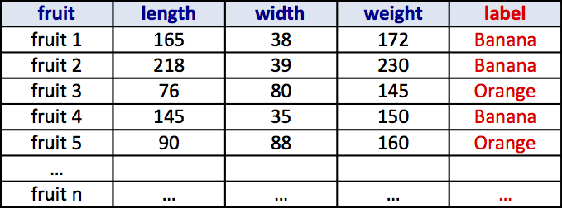
Supervised vs. Unsupervised
Given: Training data: (x₁, y₁), . . . , (xn, yn) / x_{i} ∈ R^{d} and y_{i} is the
label.
example x₁ → | ^{x}11 | ^{x}12 | . . . | ^{x}1d | y₁ ← label
. . . | . . . | . . . | . . . | . . . | . . .
example x_{i} → | ^{x}i1 | ^{x}i2 | . . . | ^{x}id | y_{i} ← label
. . . | . . . | . . . | . . . | . . . | . . .
example xn → | ^{x}n1 | ^{x}n2 | . . . | ^{x}nd | yn ← label

Slide 15
Supervised vs. Unsupervised
Unsupervised learning:
Learning a model from unlabeled data.
Supervised learning:
Learning a model from labeled data.

Slide 16
Unsupervised Learning
Training data:“examples” x.
x₁, . . . , xn, x_{i} ∈ X ⊂ R^{n}
Clustering/segmentation:
f : R^{d} −→ {C₁, . . . C_{k}} (set of clusters).
Example: Find clusters in the population, fruits, species.

Slide 17


































Unsupervised learning
Feature 2
Feature 1

Slide 18













Unsupervised learning
Feature 2
Feature 1

Slide 19
Unsupervised learning
Feature 2
Feature 1
hierarchical
Methods: K-means, gaussian spectral clustering, etc.
mixtures,
clustering,

Slide 20
Supervised learning
Training data:“examples” x with “labels” y.
(x₁, y₁), . . . , (xn, yn) / x_{i} ∈ R^{d}
Classification: y is discrete. To simplify, y ∈ {−1, +1}
f : R^{d} −→ {−1, +1} f is called a binary classifier.
Example: Approve credit yes/no, spam/ham, banana/orange.

Slide 21




































Supervised learning
!"#$%&" (
!"#$%&" )

Slide 22


Supervised learning
!"#$%&" (
!"#$%&" )
*"+,-,./ 0.%/1#&2

Slide 23
Supervised learning
!"#$%&" (
!"#$%&" )
*"+,-,./ 0.%/1#&2
Support Vector Machines, neural networks, decision
Methods:
trees, K-nearest neighbors, naive Bayes, etc.

Slide 24


































































































































































































Supervised learning
Classification:
!"#$%&" (
!"#$%&" (
!"#$%&" )
!"#$%&" )
!"#$%&" (
!"#$%&" (
!"#$%&" (
!"#$%&" )
!"#$%&" )
!"#$%&" )

Slide 25
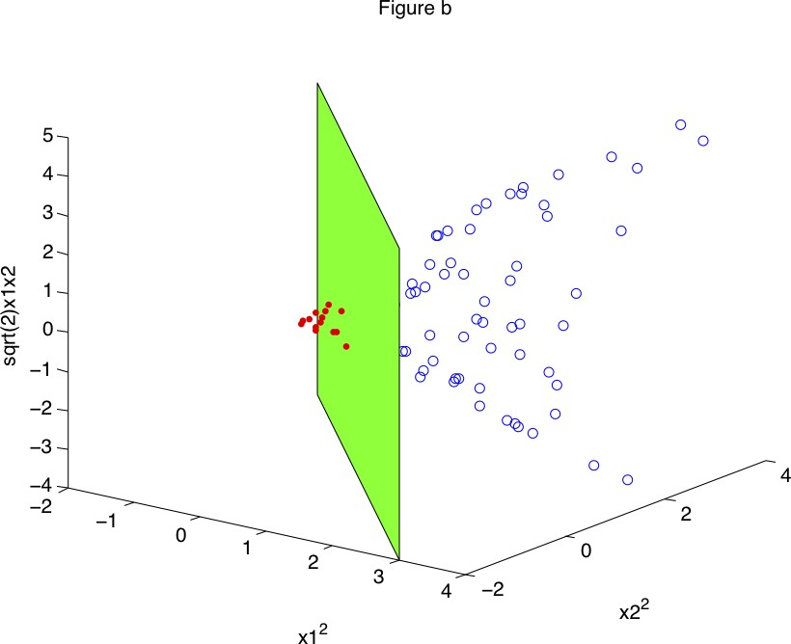
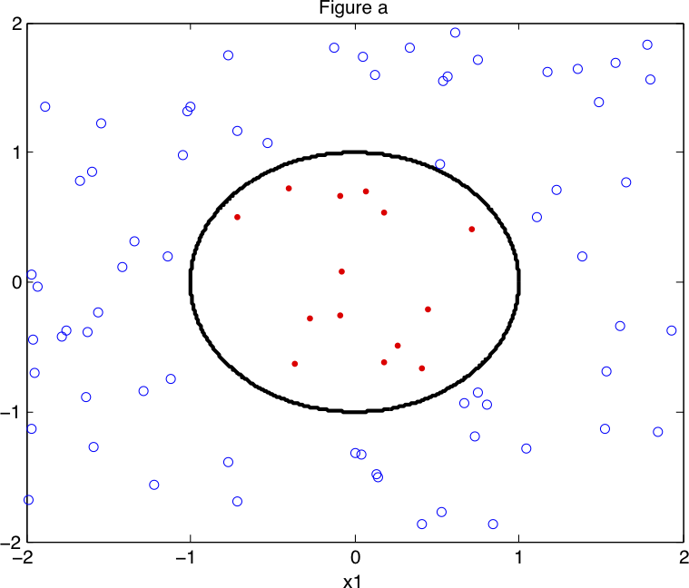
Supervised learning
Non linear classification

Slide 26
Supervised learning
Training data:“examples” x with “labels” y.
(x₁, y₁), . . . , (xn, yn) / x_{i} ∈ R^{d}
Regression: y is a real value, y ∈ R
f : R^{d} −→ R f is called a regressor.
Example: amount of credit, weight of fruit.

Slide 27

















Supervised learning
Regression:
!
#$%&'($ )
Example: Income in function of age, weight of the fruit in function of its length.

Slide 28

Supervised learning
Regression:
!
#$%&'($ )

Slide 29

Supervised learning
Regression:
!
#$%&'($ )

Slide 30


Supervised learning
Regression:
!
#$%&'($ )

Slide 31
Training and Testing
We calculate E^{train} the in-sample error (training error or em- pirical error/risk).
n
train
Σ
E
(f ) =
Aoss(y_{i}, f (x_{i}))
i=1

Slide 32
Training and Testing
We calculate E^{train} the in-sample error (training error or em- pirical error/risk).
n
train
Σ
E (f ) = Aoss(y_{i}, f (x_{i}))
i=1
Examples of loss functions:
– Classification error:
.
Aoss(y_{i}, f (x_{i})) =
1 if sign(y_{i}) ƒ= sign(f (x_{i}))
0 otherwise

Slide 33
Training and Testing
We calculate E^{train} the in-sample error (training error or em- pirical error/risk).
n
train
Σ
E (f ) = Aoss(y_{i}, f (x_{i}))
i=1
Examples of loss functions:
– Classification error:
.
Aoss(y_{i}, f (x_{i})) =
1 if sign(y_{i}) ƒ= sign(f (x_{i}))
0 otherwise
– Least square loss:
Aoss(y_{i}, f (x_{i})) = (y_{i} − f (x_{i}))²

Slide 34
Training and Testing
We calculate E^{train} the in-sample error (training error or em- pirical error/risk).
n
train
Σ
E
(f ) =
Aoss(y_{i}, f (x_{i}))
i=1
We aim to have E^{train}(f ) small, i.e., minimize E^{train}(f )

Slide 35
Training and Testing
We calculate E^{train} the in-sample error (training error or em- pirical error/risk).
n
train
Σ
E
(f ) =
Aoss(y_{i}, f (x_{i}))
i=1
We aim to have E^{train}(f ) small, i.e., minimize E^{train}(f )
We hope that E^{test}(f ), the out-sample error (test/true error), will be small too.

Slide 36

Overfitting/underfitting
An intuitive example

Slide 37

Structural Risk Minimization
High Bias Low Variance
Low Bias High Variance
Prediction Error
Test error
Training error
UnderﬁAng
Good models OverﬁAng
Complexity of the model
Low
High

Slide 38











Training and Testing
!"#$%&
!"#$%&
()&
()&
!"#$%&
()&

Slide 39
Training and Testing
!"#$%&
!"#$%&
()&
()&
High bias (underfitting)
!"#$%&
()&

Slide 40
Training and Testing
!"#$%&
!"#$%&
()&
()&
High bias (underfitting)
!"#$%&
()&
High variance (overfitting)

Slide 41
Training and Testing
!"#$%&
!"#$%&
()&
()&
High bias (underfitting)
Just right!
!"#$%&
()&
High variance (overfitting)

Slide 42
Avoid overfitting
In general, use simple models!
Reduce the number of features manually or do feature selec- tion.
Do a model selection (ML course).
Use regularization (keep the features but reduce their impor- tance by setting small parameter values) (ML course).
Do a cross-validation to estimate the test error.

Slide 43
Regularization: Intuition
We want to minimize:
Classification term + C × Regularization term
n
Σ
Aoss(y_{i}, f (x_{i})) + C × R(f )
i=1

Slide 44
Regularization: Intuition
!"#$%&
!"#$%&
!"#$%&
()&
()&
()&
f (x) = λ₀ + λ₁x ... (1)
f (x) = λ₀ + λ₁x + λ₂x² ... (2)
f (x) = λ₀ + λ₁x + λ₂x² + λ₃x³ + λ₄x⁴ ... (3)
Hint: Avoid high-degree polynomials.

Slide 45
Train, Validation and Test
TRAIN | VALIDATION | TEST
Example: Split the data randomly into 60% for training, 20% for validation and 20% for testing.

Slide 46
Train, Validation and Test
TRAIN | VALIDATION | TEST
1. Training set is a set of examples used for learning a model (e.g., a classification model).

Slide 47
Train, Validation and Test
TRAIN | VALIDATION | TEST
Training set is a set of examples used for learning a model (e.g., a classification model).
Validation set is a set of examples that cannot be used for learning the model but can help tune model parameters (e.g., selecting K in K-NN). Validation helps control overfitting.

Slide 48
Train, Validation and Test
TRAIN | VALIDATION | TEST
Training set is a set of examples used for learning a model (e.g., a classification model).
Validation set is a set of examples that cannot be used for learning the model but can help tune model parameters (e.g., selecting K in K-NN). Validation helps control overfitting.
Test set is used to assess the performance of the final model and provide an estimation of the test error.

Slide 49
Train, Validation and Test
TRAIN | VALIDATION | TEST
Training set is a set of examples used for learning a model (e.g., a classification model).
Validation set is a set of examples that cannot be used for learning the model but can help tune model parameters (e.g., selecting K in K-NN). Validation helps control overfitting.
Test set is used to assess the performance of the final model and provide an estimation of the test error.
Note: Never use the test set in any way to further tune the parameters or revise the model.

Slide 50
K-fold Cross Validation
A method for estimating test error using training data.
Algorithm:
Given a learning algorithm A and a dataset D
Step 1: Randomly partition D into k equal-size subsets D₁, . . . , D_{k}
Step 2:
For j = 1 to k
Train A on all D_{i}, i ∈ 1, . . . k and i ƒ= j, and get f_{j}. Apply f_{j} to D_{j} and compute E^{Dj}
Step 3: Average error over all folds.
k
Σ
D
(E )
j
j=1

Slide 51
Terminology review
Review the concepts and terminology:
Instance, example, feature, label, supervised learning, unsu- pervised learning, classification, regression, clustering, pre- diction, training set, validation set, test set, K-fold cross val- idation, classification error, loss function, overfitting, under- fitting, regularization.

Slide 52
Machine Learning Books
Tom Mitchell, Machine Learning.
Abu-Mostafa, Yaser S. and Magdon-Ismail, Malik and Lin, Hsuan-Tien, Learning From Data, AMLBook.
The elements of statistical learning. Data mining, inference, and prediction T. Hastie, R. Tibshirani, J. Friedman.
Christopher Bishop. Pattern Recognition and Machine Learn- ing.
Richard O. Duda, Peter E. Hart, David G. Stork. Pattern Classification. Wiley.

Slide 53
Machine Learning Resources
Major journals/conferences: ICML, NIPS, UAI, ECML/PKDD, JMLR, MLJ, etc.
Machine learning video lectures:
http://videolectures.net/Top/Computer_Science/Machine_Learning/
Machine Learning (Theory):
http://hunch.net/
LinkedIn ML groups: “Big Data” Scientist, etc.
Women in Machine Learning:
https://groups.google.com/forum/#!forum/women-in-machine-learning
KDD nuggets http://www.kdnuggets.com/

Slide 54
Credit
The elements of statistical learning. Data mining, inference, and prediction. 10th Edition 2009. T. Hastie, R. Tibshirani,
J. Friedman.
Machine Learning 1997. Tom Mitchell.

